Slide 1

Learn Programming For Kids (Python)

Slide 2
Lesson 3
Python Variables and Inputs

Slide 3

6. Python Variables
If we have to store something in our real life we need a container or box to store this so, the variables are nothing but simple containers to store data of different types like numbers, strings, boolean, chars, lists, tuples, ranges, etc.

Slide 4
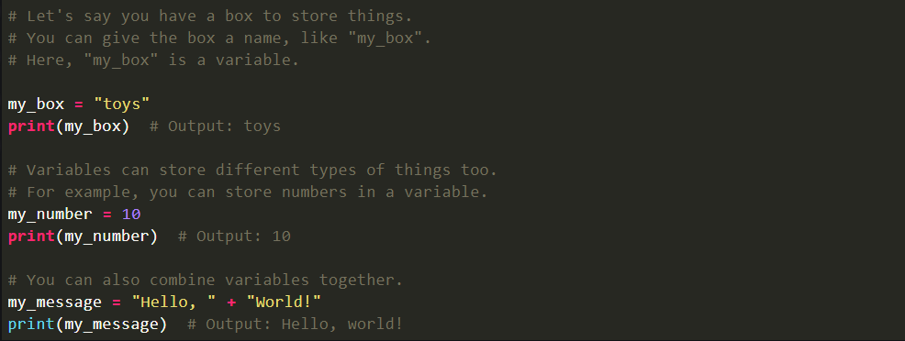
Code:

Slide 5
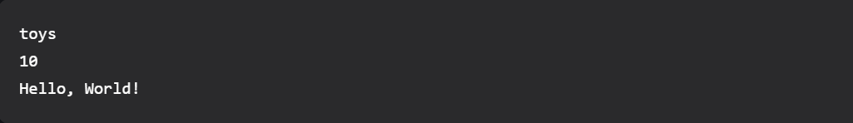
Output:

Slide 6
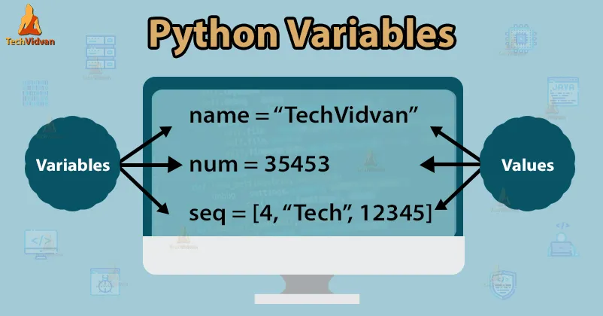
Rules for Python Variables:

Slide 7
Here are some of the rules mentioned that you must consider before naming a Python variable:
A Python variable name must start with a letter or the underscore character.
A Python variable name cannot start with a number.
A Python variable name can only contain alpha-numeric characters and underscores (A-z, 0-9, and _ ).
Variable names in Python are case-sensitive (name, Name, and NAME are three different variables).
The reserved words (keywords) in Python cannot be used to name the variable in Python.

Slide 8
7. Python Inputs
In Python, "input" is a way for your computer program to ask a question and get an answer from the person using it. It's like when you play a game and the game asks you, "What's your name?" and you type in your answer.

Slide 9
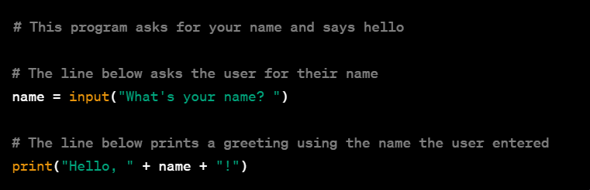
Code:

Slide 10

Output:

Slide 11
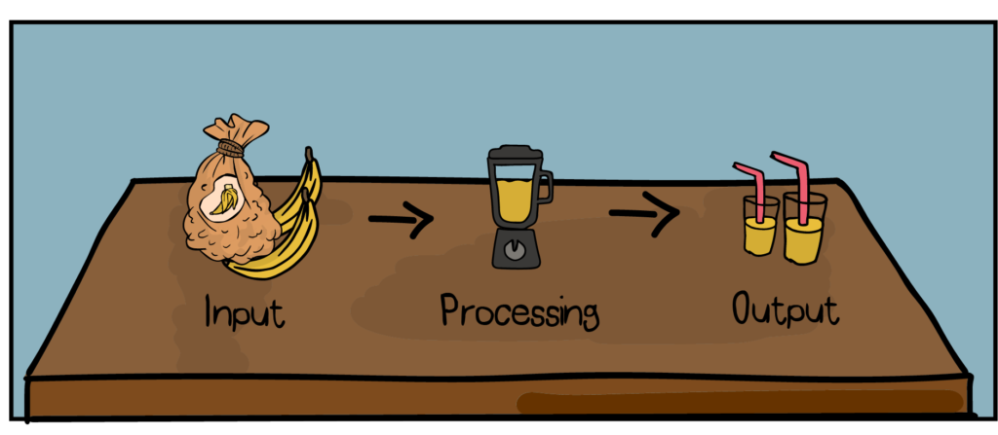
So, when you run this program, it will ask you, "What's your name?" and whatever you type will be stored in the variable called ‘name’. Then it will say, "Hello, [your name]!" on the screen.

Slide 12
The ‘input’ function lets you interact with the program by typing in information, and the program can use that information to do different things. It's a way for the computer and the person using the program to talk to each other!

